Slide 1
Conditional alphas and realized betas
Valentina Corradi, University of Surrey; Walter Distaso, Imperial College London
Marcelo Fernandes, Sao Paulo School of Economics, FGV and Queen Mary University of London
Discussion by:
Sergey Gelman, ICEF, Higher School of Economics, Moscow

Slide 2
Motivation
Give me my alpha!
Estimating small (time-variable) drift is generally complicated
Parameters are believed to change in time
Unconditional alpha is biased when conditional beta co-varies with the market risk premium or volatility
Overconditioning bias (Boguth et al. 2011JFE)
Datamining & spurious regression issues (Ferson et al. 2008 JFQA)

Slide 3
Summary (I)
Current paper:
Suggests a non-parametric approach of estimating conditional alphas
Asymptotic theory worked out
Alpha-exploiting portfolios generate significant excess returns!
(before adjusting for a 4f model)

Slide 4
Summary (II)
Two-step approach
Estimate realized betas with Barndorff-Nielsen et al. (2011JoE)
Estimate alphas from daily return residuals:
Using conditioning variables (as in Ferson et al. 2008JFQA)
And a non-parametric approach

Slide 5
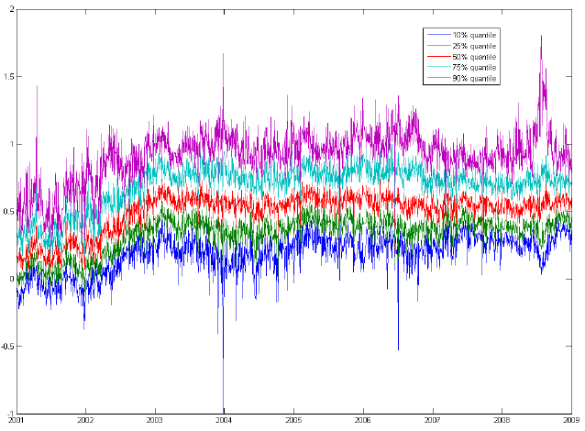
Comments (I)
Serious concern: realized betas
Results for 98 of recent S&P100 constituents
1.16
0.996
0.76

Slide 6
Comments (II)
Possibly strong downward bias in realized betas, betas possibly considerably contaminated by microstructure noise
Use 20-25 min frequency instead of tick-by-tick, as in Todorov and Bollerslev (2010JoE), Patton and Verardo (2012RFS), or use Hayashi and Yoshida (2005B) estimation approach
Robustness/alternative: option-implied betas as in Buss/Vilkov (2012RFS), Chang et al. (2012RoF)
Alphas are probably proportional to microstructure noise or illiquidity

Slide 7
Comments (III)
Alphas seem to be white noise (ACs below 0.02) – counterintuitive.
Extend bandwidth of the kernel and/or impose autocorrelation structure of alphas
Rolling window non-parametric approach similar to Li & Yang (2011JEF)
Most of the alphas disappear if you take FFC (4F) model
It seems that the conditional alpha corresponds to a loading in value or momentum
Think of more restrictive choice of conditioning variables

Slide 8
Comments (IV)
Better explanation/delineation of different estimation approaches would help (e.g. what are affine alphas?)
Transaction costs may be related to alphas– taking 4 bps does not address this issue
Try dropping EA days (Patton/Verardo 2012RFS); alternatively, look into pre-EA days – literature suggests, alphas should be negative (Barber et al. 2013 JFE)
Try dropping 2001 and 2008-2009

